Slide 1
IoT based gas leakage and monitoring sensor

Slide 2
Team members:
KAVIYANJALI.P
Ezhilarasi.S
Sangeetha.A
Thenmozhi.S

Slide 3
Abstract:
This paper presents an industrial monitoring system design using the Internet of Things (IoT). The gas sensor (MQ-5) captured information is posted into a data cloud. The sensor detects the leakage of gas under most atmospheric conditions. All the components are controlled by an Arduino (UNO-1) that acts as a central processor unit in the setup t. As soon as a gas leakage is detected by the sensor, the alarm is raised in the form of a buzzer. This alarm is supported by an LCD to display the location of leakage, alert the observer, and activate the exhaust fan in the particular section to extract leaked gas. The requirement of a gas detection system is not only to monitor continuously the surroundings but also to help prevent the gas leakage hence minimizing the chances of fire and damage.

Slide 4
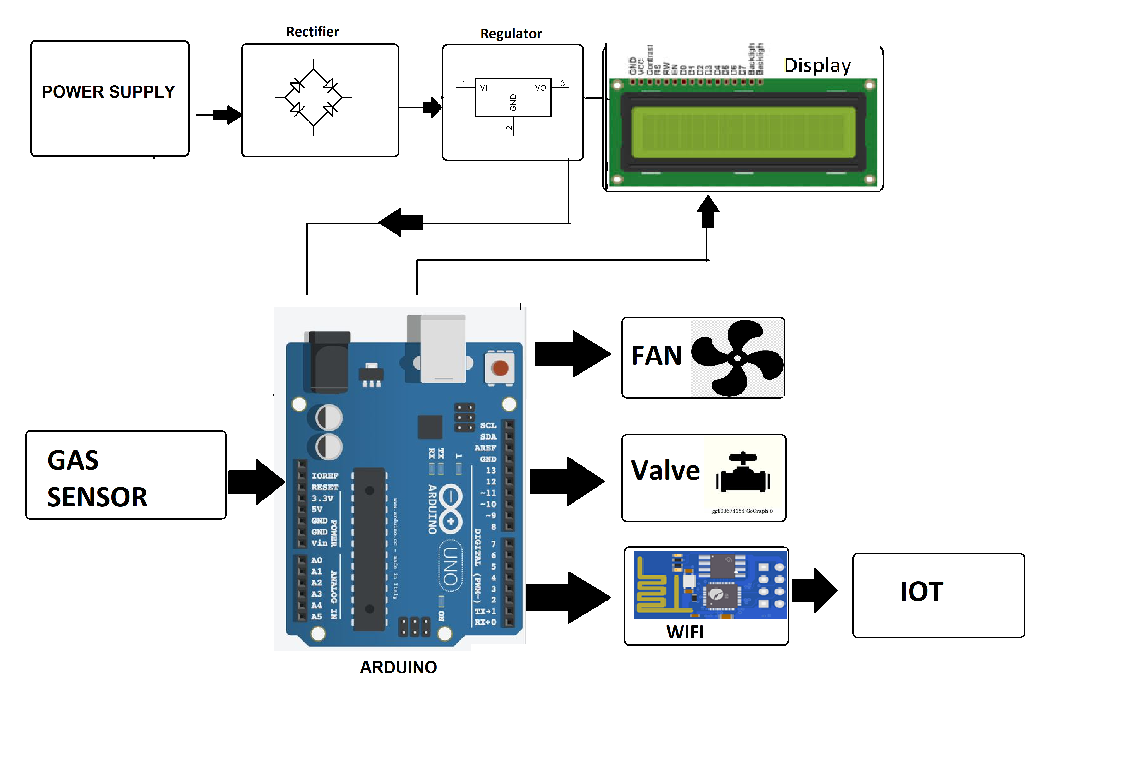
Block diagram:

Slide 5
Hardware and software used:
Transformer (230 – 12 V Ac)
2. Voltage Regulator (LM 7805)
3. Rectifier & Filter
4. Microcontroller (Atmega328)
5. Push Buttons & LCD
6. In4007 & Led
7. Resistors & Capacitors

Slide 6
Operation:
Before T2:
choosing a suitable sensor procurement of various measuring instruments and then assembly the test circuit.Test is to be performed on sensor for LPG at room conditions.
After T2:
To make an interface with the sensor, so that the sensor would be practically used to detect LPG. The interface is designedin such a way that it alerts the user if the intensity of gas increases by a certain amount.

Slide 7
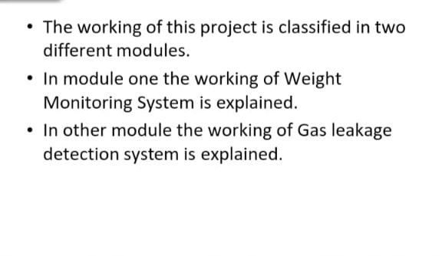
Working:

Slide 8
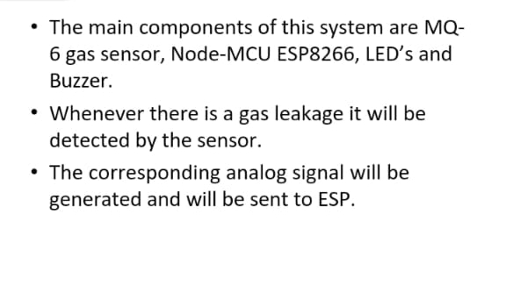
Gas leakage detection system:

Slide 9
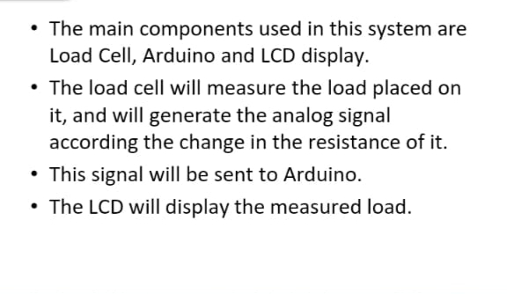
Weight monitoring system:

Slide 10
Uses:
The gas detectors can be used for the detection of combustible, flammable and poisonous gases and for loss of oxygen, and also to detected a gas leak or other pollutants. It makes the area where the leak occurs an warning sound and instructs operators to leave the area.
The system proposed is planned, built and sent an SMS warning system for detection of gas leakages.
Infrared imaging sensors have recently been used for a number of applications in industrial plants and refineries.

Slide 11
Advantages:
Get real-time alerts about the gaseous presence in the atmosphere
Prevent fire hazards and explosions
Supervise gas concentration levels
Ensure worker’s health
Real-time updates about leakages
Cost-effective installation
Data analytics for improved decisions
Measure oxygen level accuracy
Get immediate gas leak alerts

Slide 12
Application:
Safety Industries.
Indoor Air Quality/HVAC Industries.
Medical and Life-Science Industries.
Aerospace Industries.
Industrial Applications.
Agriculture Industries.
Modified Atmospheric Packaging (MAP)
Transportation Industries.

Slide 13
Conclusion:
Hence, LPG leakage detection is essential to prevent accidents and to save human lives.
This paper presented LPG leakage detection and alert system.
This system triggers LED and buzzer to alert people when LPG leakage is detected.
This system is very simple yet reliable.

